Slide 1
Practical Kinetics
Exercise 1:
Introduction to Data Analysis in Python
Objectives:
Plotting Kinetic Data
Fitting to a Rate Law
Simulating Kinetic Scenarios

Slide 2
Introduction
Kinetic Data Analysis
Plot experimental data.
Fit data to rate law and assess fit.
Simulate other plausible scenarios.
How to Use These Tutorials:
Download the IPython Notebook (.ipynb) for each exercise and follow along.
The code in each exercise can be adapted to a new set of data. You may treat the code as a black box, but you will find it more rewarding if you follow along.
Every line of code will be explained.

Slide 3
Step 1: The Import Statement
We will start by making some graphs. To do that, we need the following code:
import matplotlib
import matplotlib.pyplot as plt
%matplotlib inline
The first two lines load the matplotlib library. A library is a collection of code that has been written by someone else to perform common tasks. matplotlib is a set of codes that make graphs.
In English:
import matplotlib
“We need the matplotlib library to make graphs.”

Slide 4
Step 1: The Import Statement
import matplotlib.pyplot as plt
This line sets plt as the abbreviation for the plotting library.
Because there are thousands of Python libraries available, it is possible for the same command to have have different meanings in different libraries. This statement allows us to write plt.plot (instead of just plot) so the reference to plot is unambiguous. In general, the period “.” means “belong to.”
%matplotlib inline
This tells IPython Notebook (aka. Jupyter) to print out the graphs in the browser window. (This statement does not work in regular Python.)
In the rest of this tutorial, the necessary import statements will be provided to you. They are also summarized at the end.

Slide 5
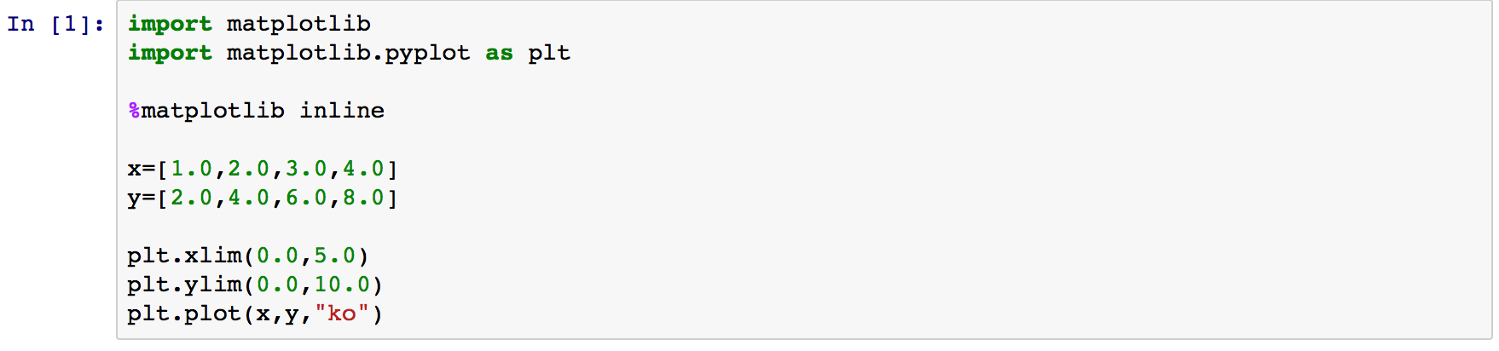
Step 2: Plot a Straight Line
In a new cell, type the following:
import matplotlib
import matplotlib.pyplot as plt
%matplotlib inline
x=[1.0,2.0,3.0,4.0]
y=[2.0,4.0,6.0,8.0]
plt.xlim(0.0,5.0)
plt.ylim(0.0,10.0)
plt.plot(x,y,"ko")
(If you are cutting and pasting, you might have to remove the blank lines. Additionally, check that the quotation marks have not been auto-replaced.)
Your window should look like this:

Slide 6
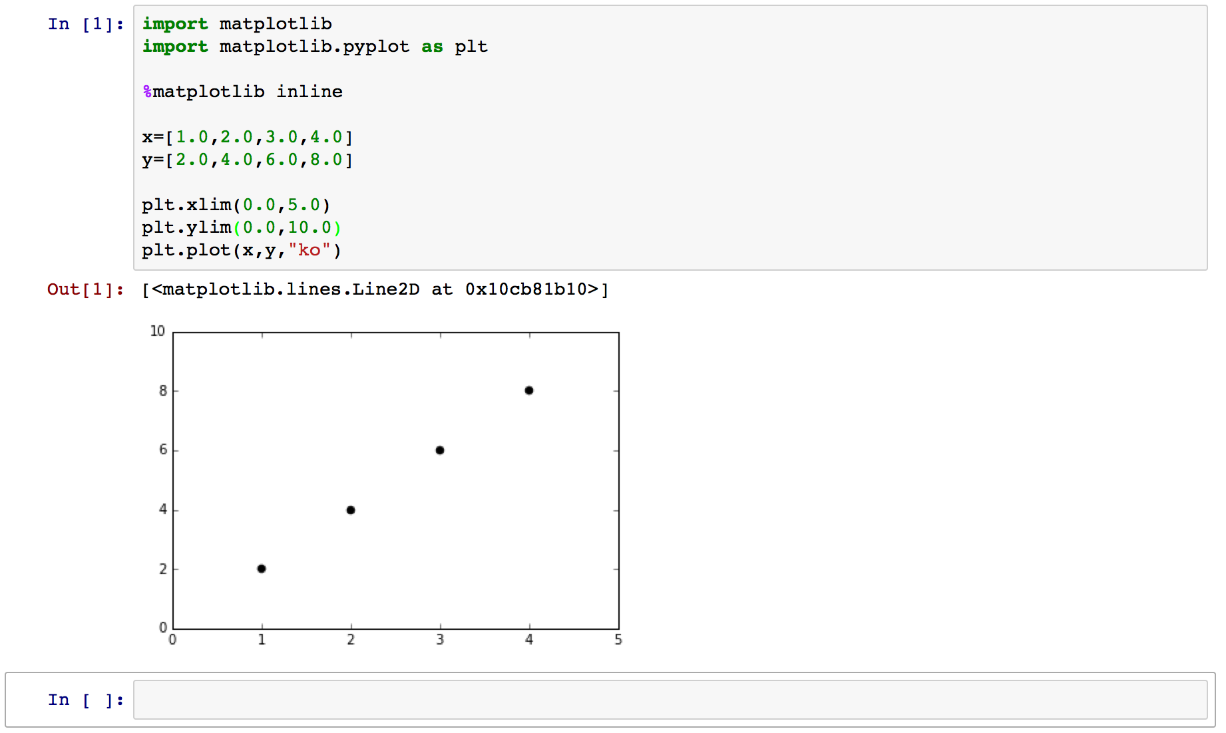
Step 1: Plot a Straight Line
Notice that pressing enter goes to the next line and does not execute anything.
To execute the code, press shift-enter. A plot will appear underneath:

Slide 7
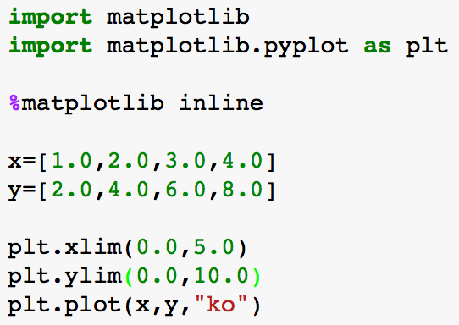
Step 1: Plot a Straight Line
The import statements.
Plot graphs in the browser.
The (x,y) coordinates.
Specify “.0” after
any integers.
The x and y axis limits.
In English, the last line means:
“Plot y vs. x using black circles (o).”
In a new cell, delete the “o” and press shift-enter again to re-evaluate the cell. (That’s a lowercase o, as in “oak.”)

Slide 8
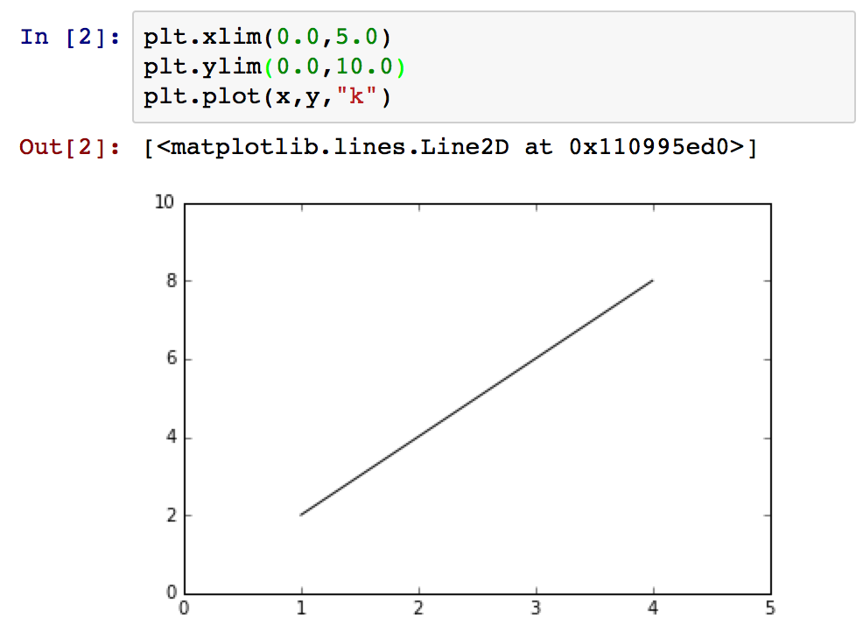
Step 1: Plot a Straight Line
Without the “o,” just the line is plotted:
Notice that the import statements only have to be specified once. Once imported, the libraries stay loaded for the rest of the session.
Similarly, x and y were already defined in the first cell, and are now stored in memory.

Slide 9
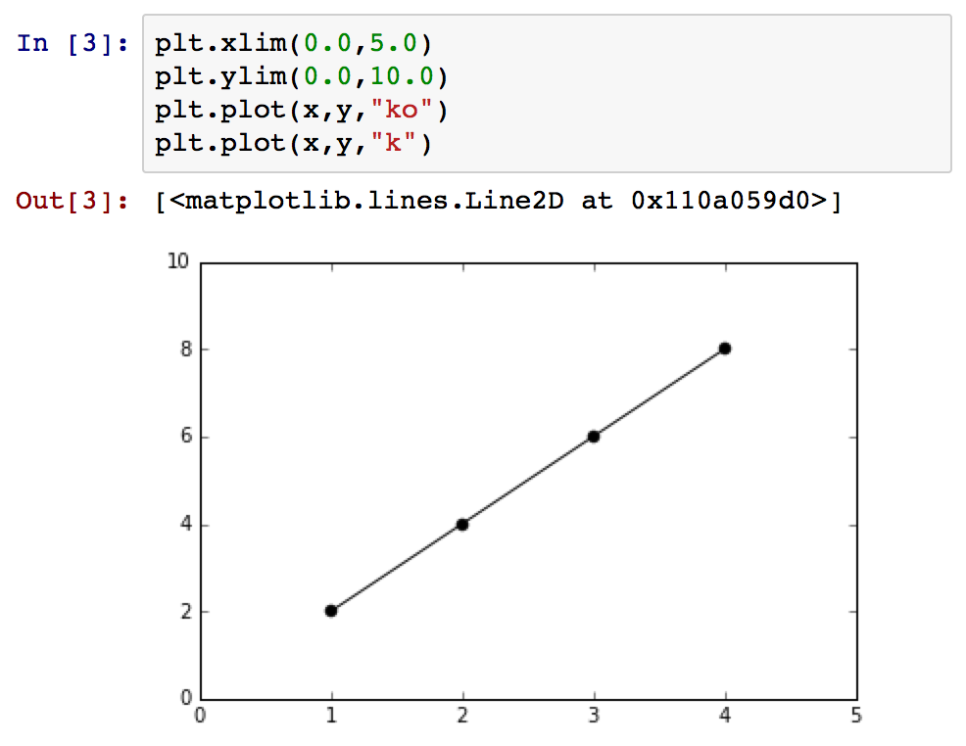
Step 2: Overlaying Plots
When multiple plot statements are present, the plots are automatically overlaid:

Slide 10
Step 3: Formatting Plots
In each plot command, the third argument is the “format string”:
plt.plot(x,y, ”ko” )
Each format string is a combination of a color abbreviation and a line style abbreviation:
colors: r = red, b = blue, g = green, k = black
line styles
(nothing) connect points with straight, solid lines
-- connect lines with straight, dashed lines
. (a period) mark points with dots
o mark points with circles
+ mark points with crosses

Slide 11
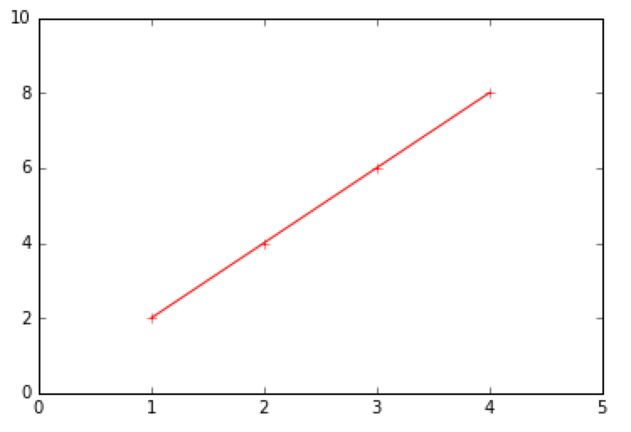
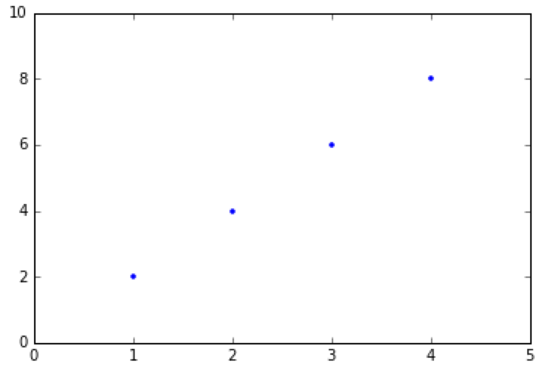
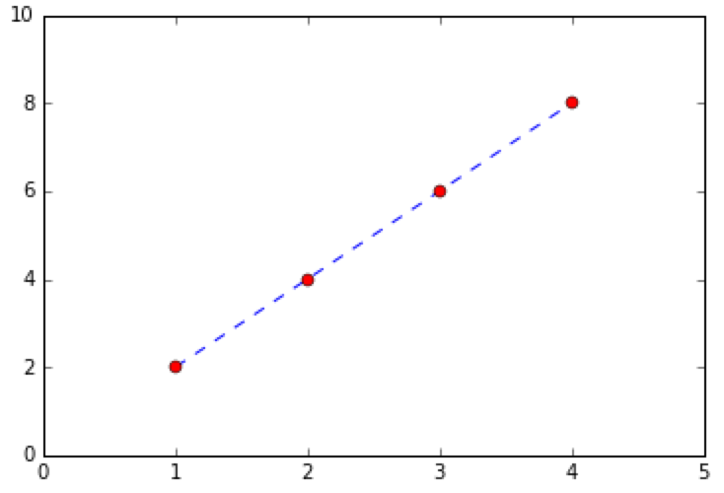
Step 3: Formatting Plots
Here are a few examples:
plt.plot(x,y,”r”)
plt.plot(x,y,”r+”)
plt.plot(x,y,”b.”)
Remember, the color goes first and the line style goes second.
plt.plot(x,y,”b--”)
plt.plot(x,y,”ro”)

Slide 12
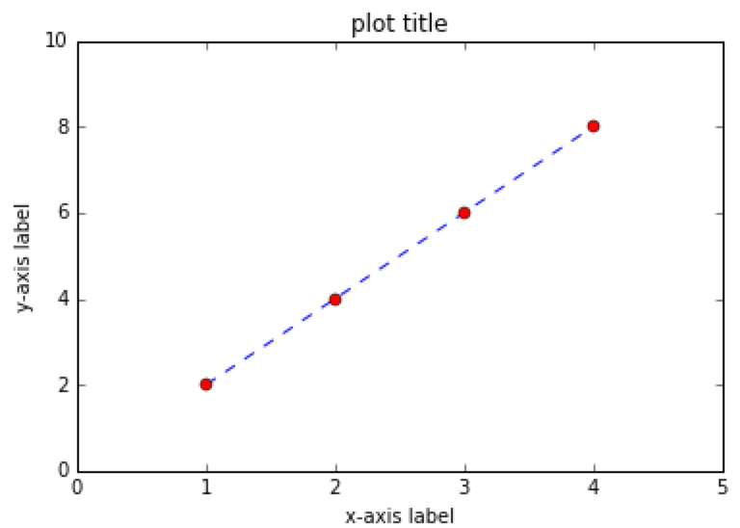
Step 4: Labeling Plots
Try adding the following:
plt.xlabel("x-axis label")
plt.ylabel("y-axis label")
plt.title("plot title")
Note: Further customization of fonts,
legends, line styles, etc. is possible. See:
http://matplotlib.org/users/pyplot_tutorial.html
Saving plots: If you want to save your plot to disk, add a line:
plt.savefig("my_plot.png")
This will save a graphic to the directory you started IPython Notebook in.
You can replace .png with .pdf to make PDF files.

Slide 13
Step 5: Introduction to Lists
Preivously wrote:
x=[1.0,2.0,3.0,4.0]
y=[2.0,4.0,6.0,8.0]
These are called lists: ordered sequences of objects. (We’ll deal with lists that contain numbers, but they can contain other things too.)
Each element has an index:
x=[1.0, 2.0, 3.0, 4.0]
Notice that the numbering starts at 0, not 1.
element 1
element 3
element 0
element 2

Slide 14
Step 5: Introduction to Lists
The symbol x is the name of the list:
x=[1.0, 2.0, 3.0, 4.0]
To access an element directly:
result:
print x[0] 1.0
To change an element of x:
result:
x[0]=8.0
print x [8.0, 2.0, 3.0, 4.0]
To find out how many elements x contains:
result:
print len(x) 5
name of list

Slide 15
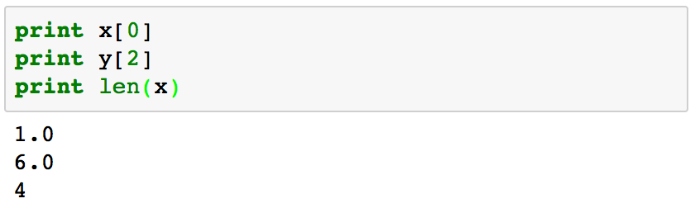
Step 5: Introduction to Lists
In a new cell, try typing:
print x[0]
print y[2]
print len(x)
Press shift-enter to evaluate again.
Does this make sense given the previous code?
x=[1.0,2.0,3.0,4.0]
y=[2.0,4.0,6.0,8.0]
In English: the 0th element of x is 1.0. The third element of y is 6.0. There are 4 items in the list x.

Slide 16
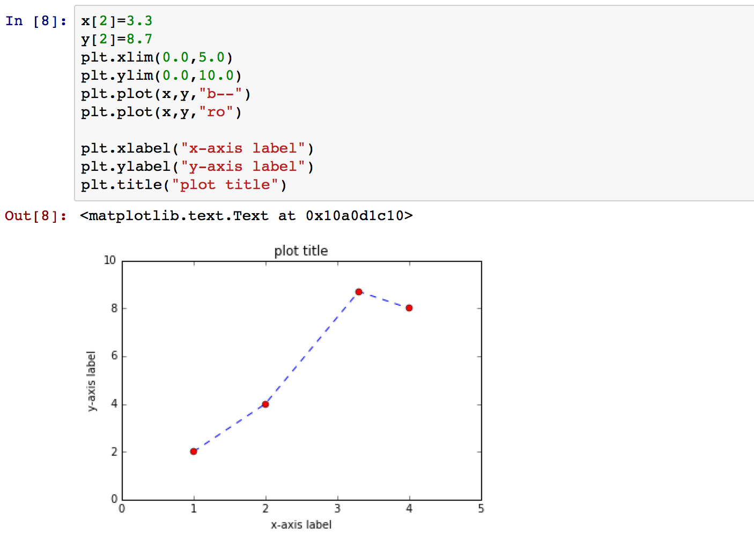
Step 5: Introduction to Lists
In a new cell:
Change the third point to (3.3, 8.7). Remember, the third point means index = 2. Re-plot the result.
Note: If you scroll back up in your notebook, you will see that the previous plots have not changed. If you were to re-evaluate them, they would be updated to reflect your changes to x and y.

Slide 17
Step 6: List Comprehensions
Instead of entering numbers into lists manually, we can use mathematical expressions.
The simplest command is range:
list1 = range(5) Result:
print list1 [0, 1, 2, 3, 4]
print len(list1) 5
Typing in range(n) returns the numbers from 0 to n-1 as a list:
range(n) = [0, 1, ..., n-1]

Slide 18
Step 6: List Comprehensions
We can use range to generate more complicated lists:
list1 = range(5)
list1 = [0, 1, 2, 3, 4]
list2 = [ i*2 for i in list1 ] Result:
print list2 [0, 2, 4, 6, 8]
Placing an expression in square brackets to define a list is called making a list comprehension.
In English:
“Take each item in list1, one at a time, and call it i. Multiply i by 2 and put the result in list2.”
Taking items one at a time from a list is called iteration.

Slide 19
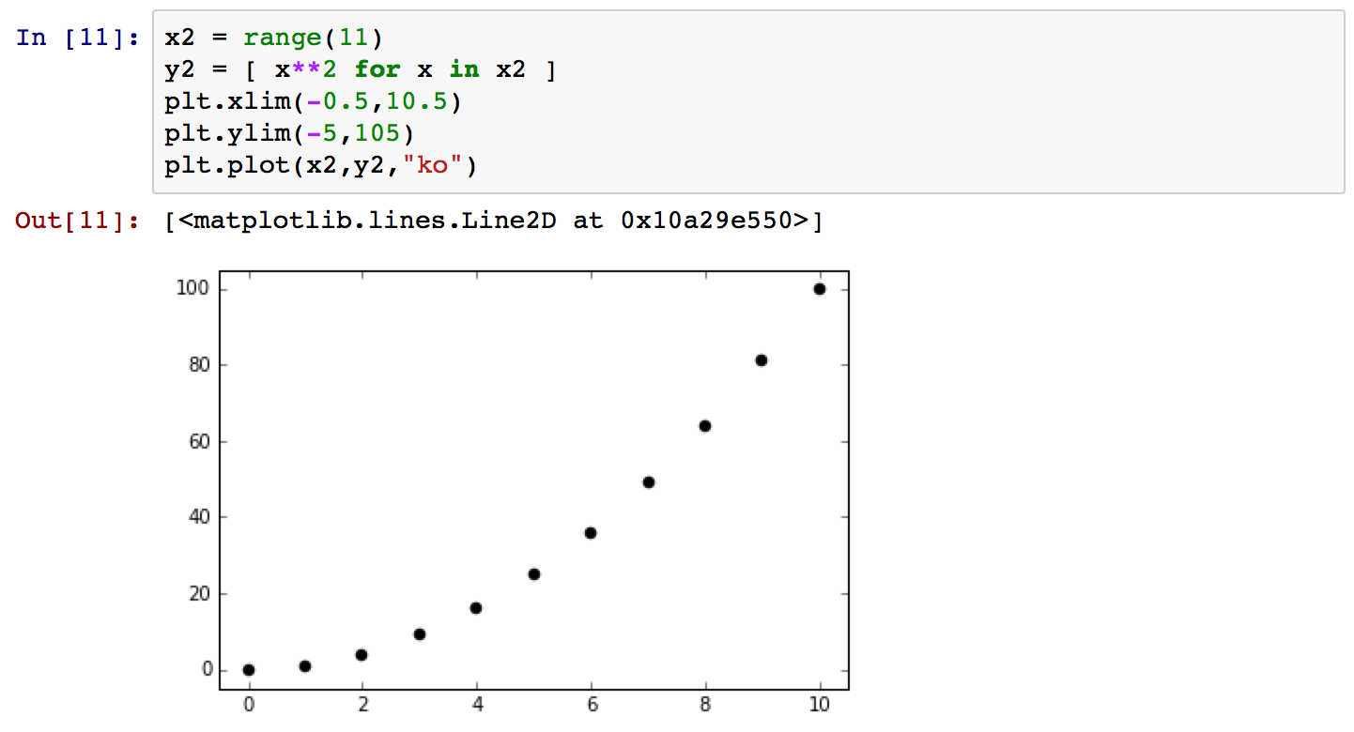
Step 6: List Comprehensions
In a new cell, plot the function y=x² from 0 to 10 using a list comprehension.
Notice that we need range(11), not range(10).
x**2 means x raised to the power of 2.

Slide 20
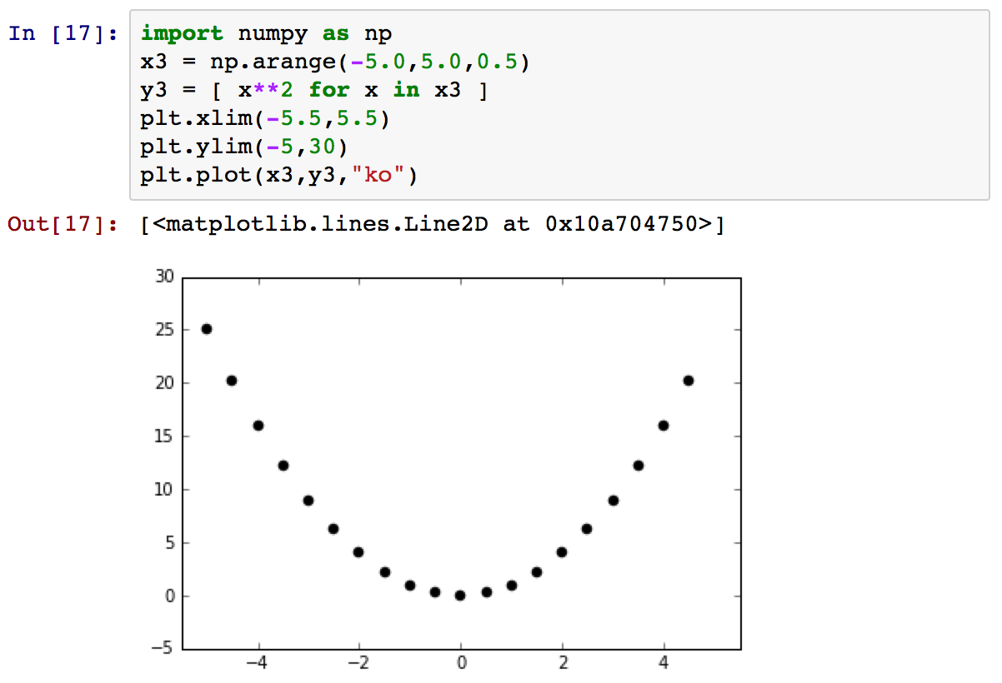
Step 7: Using NumPy
What if we wanted to plot from –5 to +5, every 0.5? Instead of range, we need a more generalized function called np.arange:

Slide 21
Step 7: Using NumPy
import numpy as np
This loads the NumPy (Numerical Python) library. This library contains
many routines for doing math with lists.
To refer to a NumPy function instead of a regular Python function,
we need to preface the function’s name with np.
sqrt (regular Python)
np.sqrt (numpy)
np.arange(-5.0, 5.0, 0.5)
“Fill a list with the numbers from –5 to +5 every 0.5.” Just like with the
range function, the last point is not included.
The general syntax is:
np.arange(start, stop, step_size)

Slide 22
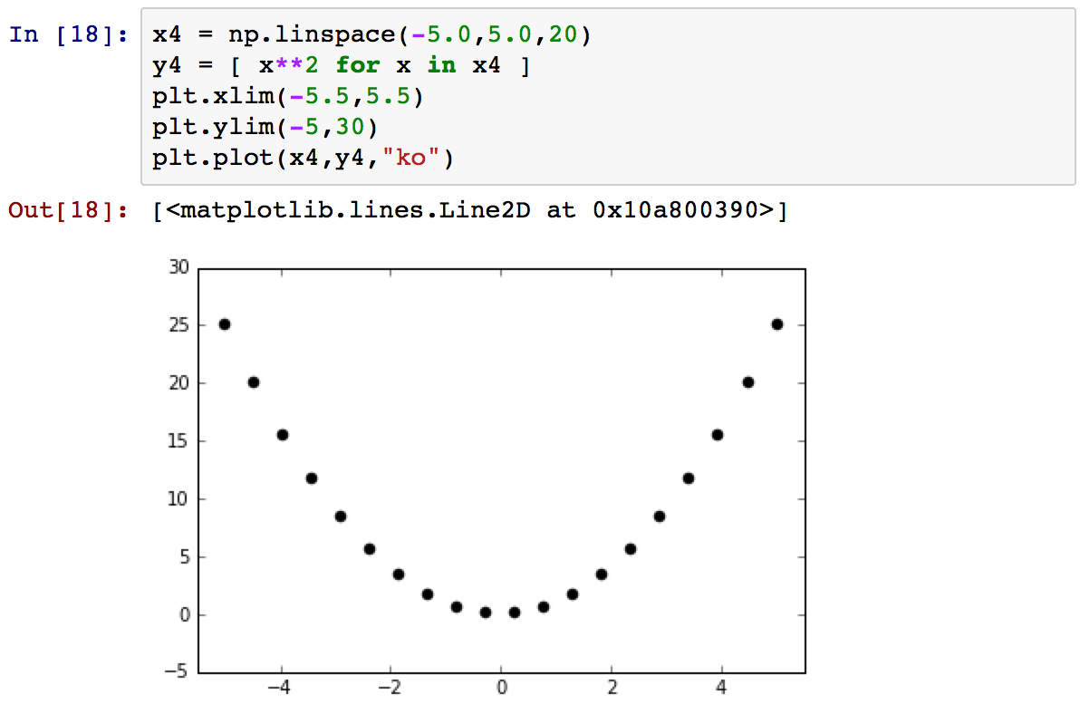
Step 7: Using NumPy
To fill the range from –5 to +5 evenly with 20 points, you can use np.linspace:
With np.linspace, the last point is included.

Slide 23
Step 8: First-Order Kinetics
Recall that for a first-order reaction:
To simulate the timecourse of a reaction, enter the following in a new cell:
from math import exp
import numpy as np
time = np.arange(0.0,10.0,0.1)
initial_concentration = 1.0
rate_constant = 1.0
concentration = [ initial_concentration *
exp(-rate_constant*t) for t in time ]
plt.plot(time, concentration, "k.")
Technical Note: Strictly speaking, we don’t have to include the NumPy import again.
Place this on one line.

Slide 24
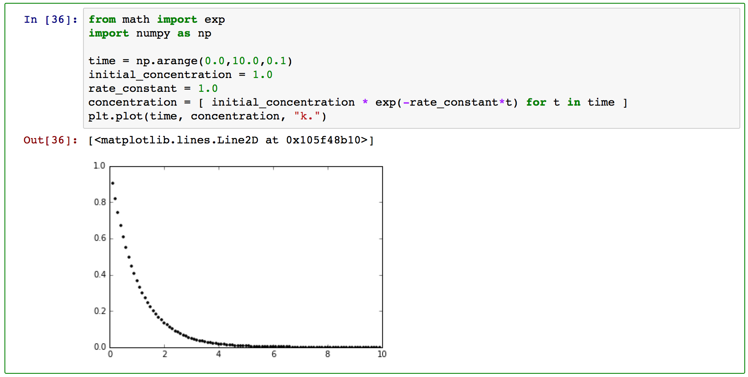
Step 8: First-Order Kinetics
from math import exp
“From now on, whenever I type exp, interpret that to mean the exp function
from the math library.”
0 to 10 seconds in 0.1 s steps
the integrated rate law as a
list comprehension
[A]
time (s)

Slide 25
Step 9: Make a Log Plot
Recall that a log plot will show a straight line:
You can perform log calculations with:
from math import log
log_concentration = [ log(conc) for conc in concentration ]
plt.plot(time, log_concentration, "k.")
Try this out in a new cell.

Slide 26
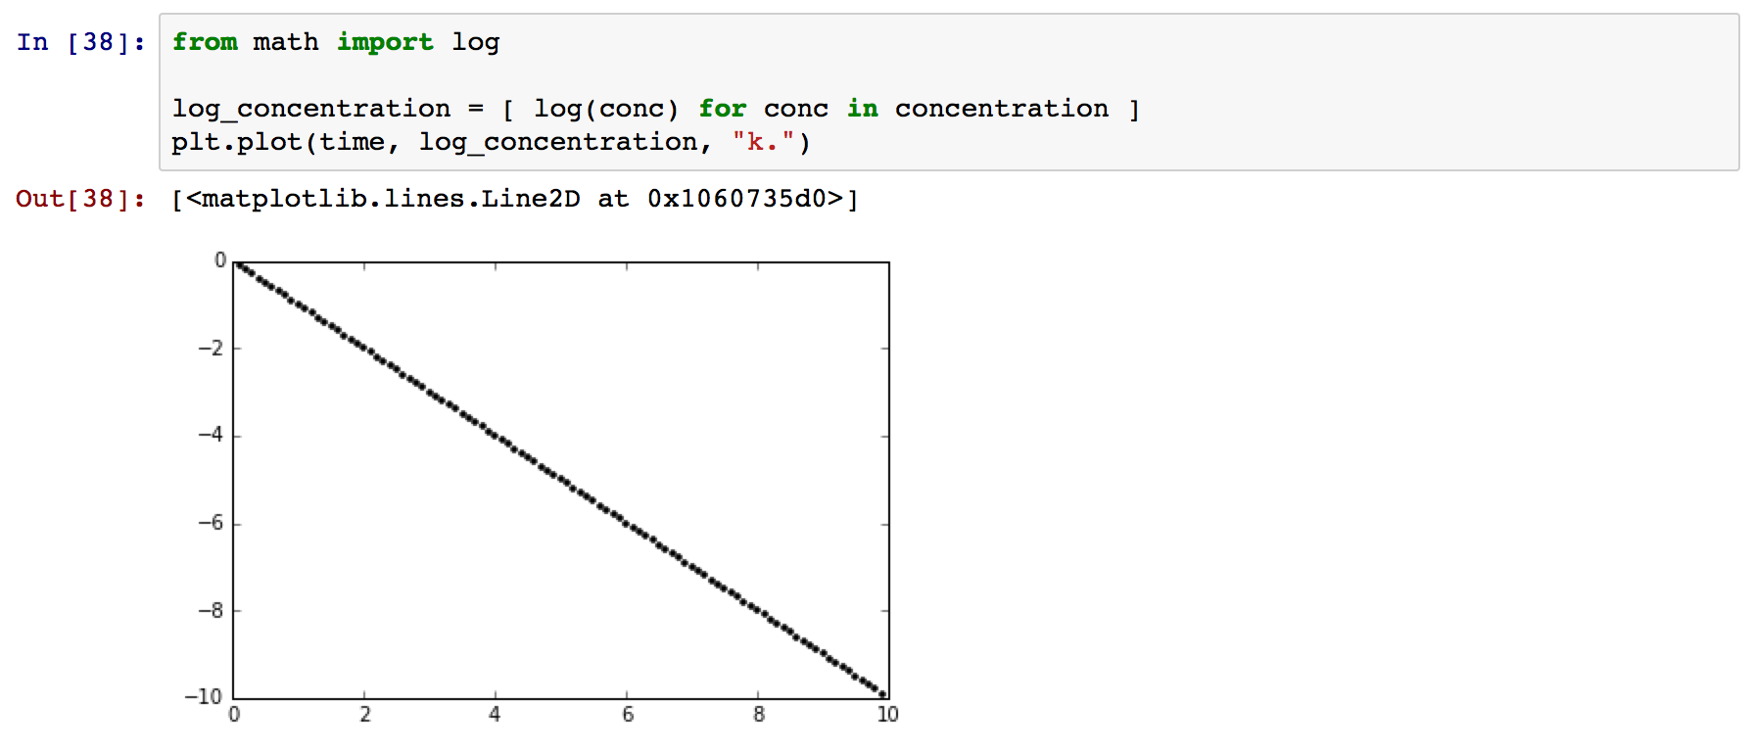
Step 9: Make a Log Plot
This is a straight line with unit negative slope.
The list comprehension “iterates” over concentration to produce a new list:
“Take each value in the concentration list, one at a time, take the logarithm and add it to a new list called log_concentration.”
Note that log means the natural logarithm (ln). You can use log10 for base 10.
ln [A]
time

Slide 27
Step 10: Fit a Straight Line
What if you wanted to fit a straight line to get the slope and intercept?
In a new cell, try this:
from scipy.optimize import curve_fit
def f(x, m, b):
return m*x + b
optimized_parameters, covariance_matrix = curve_fit(f, time, log_concentration)
slope = optimized_parameters[0]
intercept = optimized_parameters[1]
print ”optimized_parameters:", optimized_parameters
print ”covariance_matrix:", covariance_matrix
print
print "slope: ", slope
print "intercept: ", intercept

Slide 28
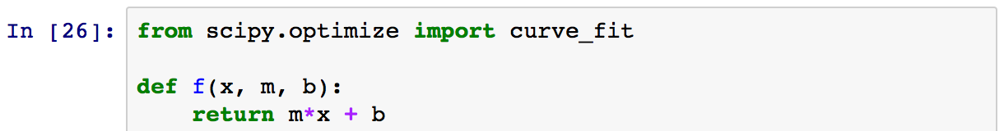
Step 10: Fit a Straight Line
from scipy.optimize import curve_fit
SciPy (Scientific Python) is a standard Python library that contains many routines scientific computing. In this case, we are importing the curve_fit function from the SciPy optimization library.
def f(x, m, b):
return m*x + b
“Define a function f that takes three parameters: x, m, and b. Return m x x + b whenever f is called.”

Slide 29
Step 10: Fit a Straight Line
def f(x, m, b):
return m*x + b
optimized_parameters, covariance_matrix = curve_fit(f, time, log_concentration)
slope = optimized_parameters[0]
intercept = optimized_parameters[1]
curve_fit is a function in scipy.optimize.
The information we pass to curve_fit is in the parentheses.
curve_fit(f, time, log_concentration)
f, the functional form of the curve we want to fit
time, the x values
log_concentration, the y values
curve_fit adjusts m and b in f to minimize the sum of squares between f(time, m, b) and log_concentration.

Slide 30
Step 10: Fit a Straight Line
def f(x, m, b):
return m*x + b
optimized_parameters, covariance_matrix = curve_fit(f, time, log_concentration)
slope = optimized_parameters[0]
intercept = optimized_parameters[1]
When curve_fit is finished, the result is stored in optimized_parameters and covariance_matrix.
The first element of optimized_parameters is the slope (m). The second is the intercept (b).
The order is determined by the ordering of parameters for f. The independent variable (x) must always come first. Any subsequent parameters will be adjusted to minimize the sum of squares and returned in optimized_parameters, in the same order.
Had we defined f(x, b, m), the ordering would be reversed.

Slide 31
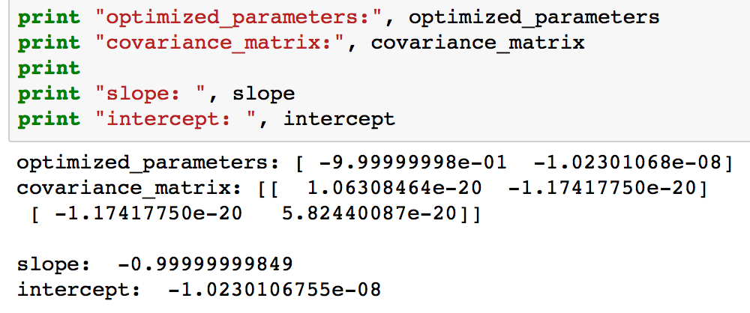
Step 10: Fit a Straight Line
This is a line with unit negative slope and zero intercept (to within numerical precision). -1.02E-08 means –1.02 x 10^{–8}.
Technical Note:
covariance_matrix contains the (symmetric) covariance matrix for the parameter estimates. The nested square brackets mean that this is really a 2x2 matrix. The diagonal entries covariance_matrix[0][0] and covariance_matrix[1][1] represent the uncertainties of the slope and intercept, respectively. The off-diagonal entries indicate how the uncertainty in slope and intercept are related. In this case, the uncertainties are very small and meaningless because no error bars were passed to curve_fit.

Slide 32
Step 10: Fit a Straight Line
Let’s plot the result. In a new cell:
best_fit = [ f(x, slope, intercept) for x in time ]
plt.plot(time[::5], log_concentration[::5], "k+", label="data")
plt.plot(time, best_fit, "b", label="fit")
plt.legend()
The time[::5] notation tells Python to take every fifth point in the time list and create a new list. I did that so the points aren’t jammed together.
The plt.legend() command requests that a legend be added to the plot.

Slide 33
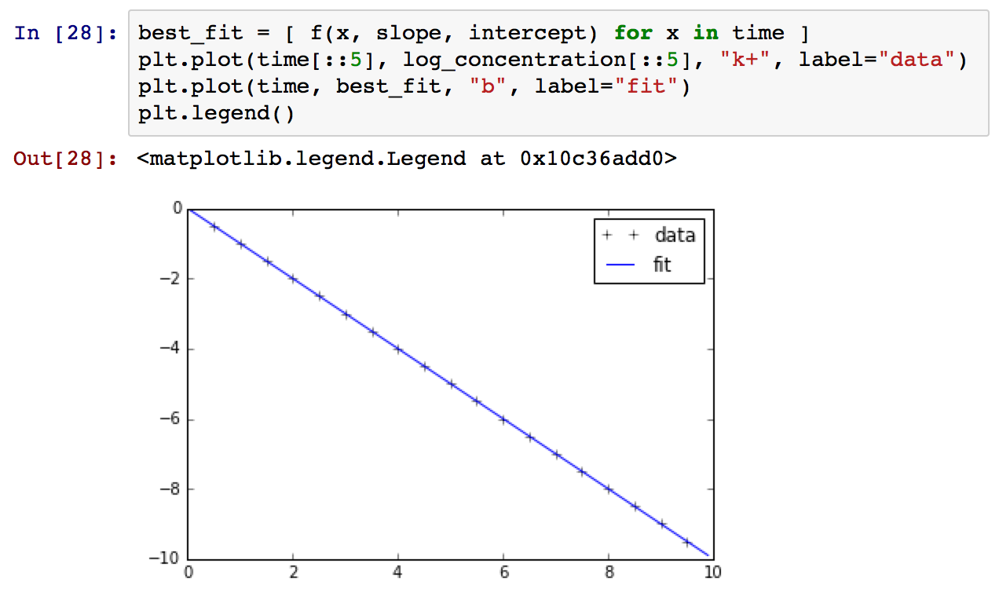
Step 10: Fit a Straight Line
The fit is perfect because this the data are synthetically generated.
ln [A]
time

Slide 34
Step 11: Non-Linear Curve Fitting
There is no reason that f must be linear! Instead of fitting log(concentration) vs. time, let’s fit concentration vs. time directly.
In a new cell, type this:
def f2(t, initial_concentration, k):
return initial_concentration*np.exp(-k*t)
popt, pcov = curve_fit(f2, time, concentration)
fitted_initial_concentration = popt[0]
fitted_k = popt[1]
print "fitted initial concentration:", fitted_initial_concentration
print "fitted rate constant:", fitted_k
best_fit2 = [ f2(t, fitted_initial_concentration, fitted_k) for t in time ]
plt.plot(time[::5], concentration[::5], "k+", label="data")
plt.plot(time, best_fit2, "b", label="fit")
plt.legend()
Technical Notes:
I changed optimized_parameters, covariance_matrix to their conventional short forms, popt, pcov. (They are short for: parameters, optimal and parameters, covariance.)
We need np.exp instead of exp because the latter does not work on arrays.

Slide 35
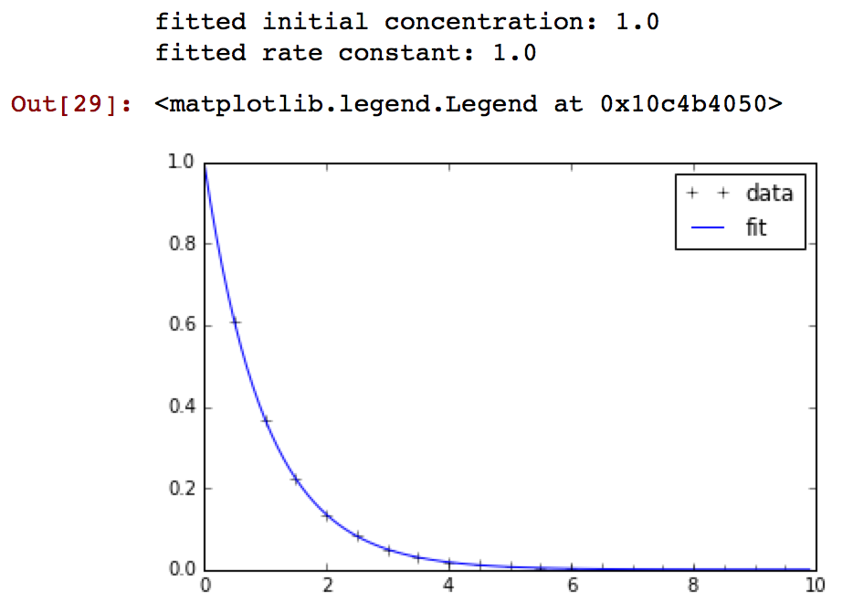
Step 11: Non-Linear Curve Fitting
The parameters are exactly recovered:
Technical Notes: The initial_concentration variable inside f2 is shadowed, meaning that its value is local to the scope of the function. It is not the same as the initial_concentration variable defined in previous cells. You can think of it as a dummy variable that disappears as soon as the f2 evaluates.
ln [A]
time

Slide 36
Step 12: The Two Step System
There are three ways to treat this system:
1. Pre-Equilibrium Approximation
Assume that the ratio K = [B]/[A] is maintained at its thermodynamic value,
k₁/k_{–1}. This is valid if the subsequent rate constant, k₂, is relatively slow.
2. Steady State Approximation
Alternatively, we could assume that d[B]/dt ≈ 0 ([B] changes much more slowly
than [C]). This means that [B]/[A] would be held at its kinetic value of k₁/(k₋₁+k₂).
This is valid of k₂ is fast.
3. Differential Equations
If we solve the differential equations exactly, we can see when the pre- equilibrium and steady state approximations are valid. We will do that here.

Slide 37
Step 12: The Two Step System
The integrated rate laws for this system are:
The derivation uses the Laplace Transform (J. Chem. Educ. 1999, 76, 1578).
I have presented the solution into a more convenient form (Chemical Kinetics and Catalysis Notes 2011, Professor Clark Landis, University of Wisconsin-Madison).

Slide 38
Step 12: The Two Step System
Taking approach 3, let’s compute the timecourse of the following reaction:
Simulation Parameters:
k_1 = 10.0 k_minus1 = 100.0
k_2 = 0.1
A_initial = 1.0
Plot from 0.0 to 5.0 seconds.
We’ll do this step by step.

Slide 39
Step 12: The Two Step System
In a new cell:
k_1 = 10.0
k_minus1 = 100.0
k_2 = 0.1
A_initial = 1.0
from math import sqrt
p = k_1 + k_minus1 + k_2
q = sqrt(p**2 - 4*k_1*k_2)
lambda_2=(p+q)/2.0
lambda_3=(p-q)/2.0
c_1 = (k_1*A_initial)/(lambda_2-lambda_3)
c_2 = (lambda_2-k_2)/lambda_2
c_3 = (lambda_3-k_2)/lambda_3

Slide 40
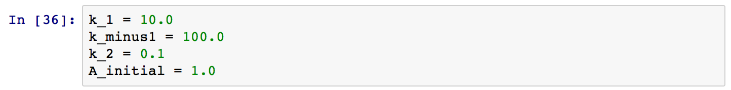
Step 12: The Two Step System
First, setup some variables:
We can reevaluate this cell later when we want to change the rate constants.
Next, calculate:
None of these variables depends on time, so it makes sense to calculate them ahead of time.

Slide 41
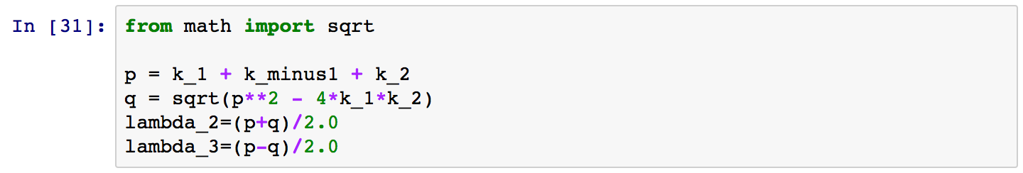
Step 12: The Two Step System
Again, we need an import statement to perform square roots.

Slide 42
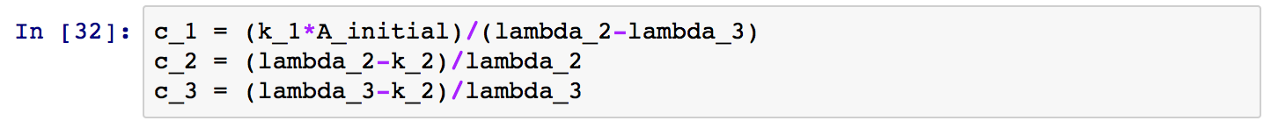
Step 12: The Two Step System
Examining the expressions for [A] and [B], we find that there are constants that also do not depend on time. I highlighted one of them.
Let’s define those, too:
Remember, if we change the rate constants later, we’ll have to re-evaluate all of these cells to update everything.

Slide 43
Step 12: The Two Step System
In a new cell:
def A(t):
return c_1 * (c_2 * exp(-lambda_2*t) - c_3 * exp(-lambda_3*t))
def B(t):
return c_1 * (exp(-lambda_3*t)-exp(-lambda_2*t))
time = np.arange(0.0,5.0,0.01)
conc_A = [ A(t) for t in time ]
conc_B = [ B(t) for t in time ]
conc_C = [ A_initial - conc_A[i] - conc_B[i] for i in range(len(time)) ]
plt.plot(time, conc_A, "r", label="[A]")
plt.plot(time, conc_B, "g", label="[B]")
plt.plot(time, conc_C, "b", label="[C]")
plt.legend()

Slide 44
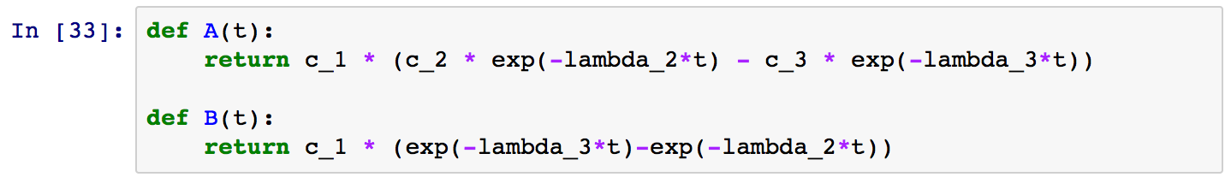
Step 12: The Two Step System
Now, let’s create functions for [A] and [B]. We will calculate [C] by mass balance later.
Technical Note: These functions depend on variables that are outside their scope. For example, c_1 appears inside A(t) even though it is not defined there. This is perfectly acceptable in Python.

Slide 45
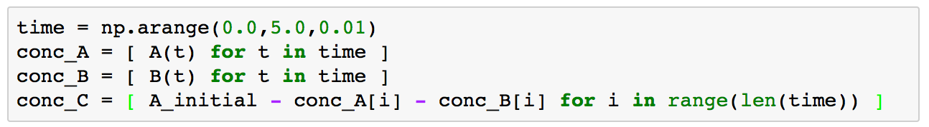
Step 12: The Two Step System
Now we need to run the simulation.
First, we fill up the time list with values from 0.0 to 5.0 in steps of 0.01.
Then, we iterate over time. For each value t in time, we call the function A to get the value A(t). These values are placed, one at a time, in conc_A.
We do the same thing for [B]. For [C], we use mass balance:
“The total concentration minus [A] minus [B] for every point in time.”

Slide 46
Step 12: The Two Step System
Step by step:
len(time) returns the number of time points (i.e., the number of elements in time)
range(len(time)) returns a list [0, 1, ..., len(time)-1]. We can use this to iterate over each list in parallel, since each list has the same number of elements.
Finally, conc_C = [ A_initial – conc_A[0] – conc_B[0],
A_initial – conc_A[1] – conc_B[1],
...,
A_initial – conc_A[n-1] – conc_B[n-1] ]
where n = len(time).
In English, this is the total concentration minus [A] minus [B] for every point in time.

Slide 47
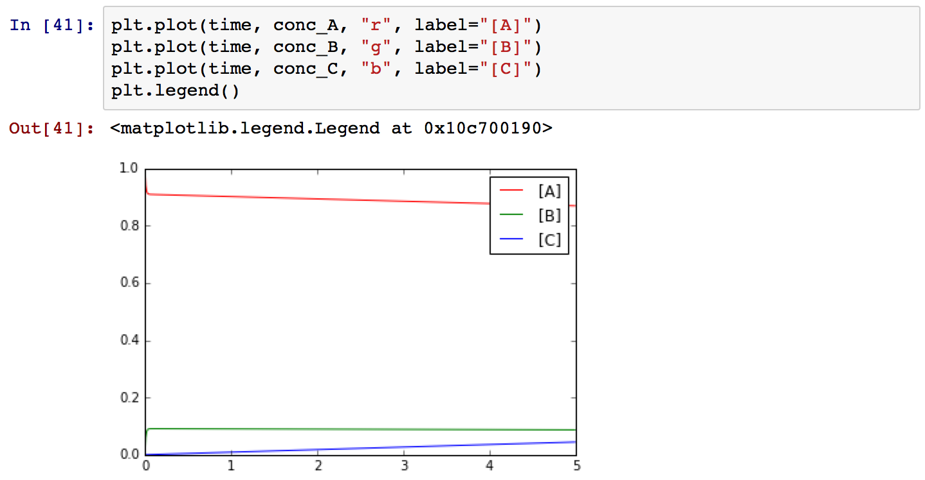
Step 12: The Two Step System
Here is the plot of the result:
Would you call this pre-equilibrium, steady state, or neither?
To find out, let’s plot [B]/[A].
conc.
time

Slide 48
Step 13: Pre-Equilibrium or Steady State?
In a new cell:
conc_ratio = [ conc_B[i] / conc_A[i] for i in range(len(time)) ]
plt.ylim(0.08,0.12)
plt.plot(time, conc_ratio, "k", label="[B]/[A]")
plt.legend()
This divides [B]/[A] for each point in time.
The “foreach” expression
for i in range(len(time))
iterates over [0, 1, ..., len(time)-1], the indices of conc_A and conc_B.

Slide 49
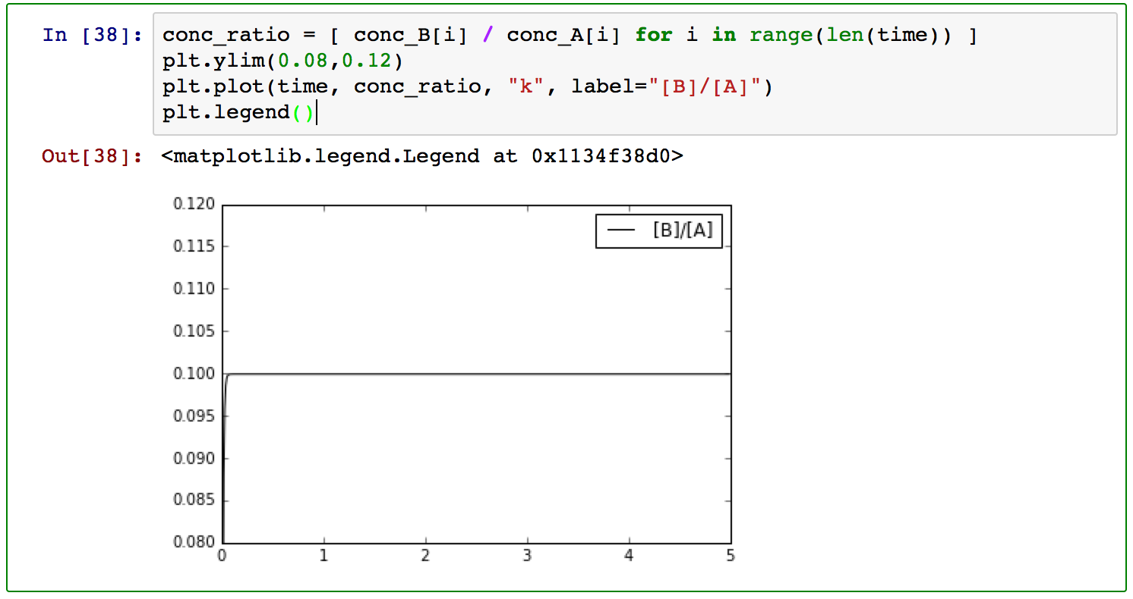
Step 13: Pre-Equilibrium or Steady State?
The ratio is 1:10 for most of the reaction. Recall, k_1 = 10.0,
k_minus1 = 100.0, k_2 = 0.1. The thermodynamic ratio is k₁/k_{–1} = 0.1, so this is pre-equilibrium. This happens when k₂ is slow relative to k₁ and k₋₁.
conc.
time

Slide 50
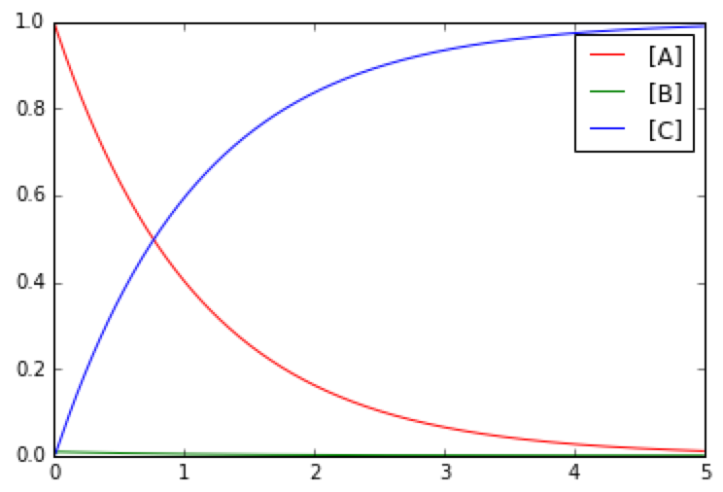
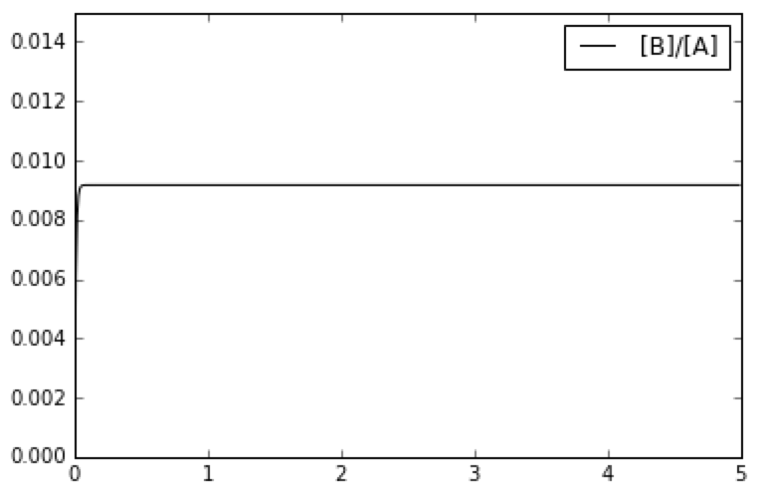
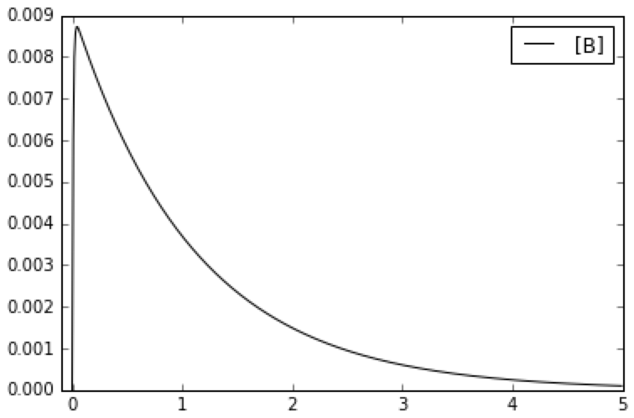
Step 13: Pre-Equilibrium or Steady State?
What if k₂ is fast? Re-run the simulation (re-evaluate cells) with:
k_1 = 1.0 k_minus1 = 10.0 k_2 = 100.0
This is steady-state:
In this case, [B]/[A] = 1/(10+100) = 0.009, matching the figure above. This is the “kinetic equilibrium” value.

Slide 51
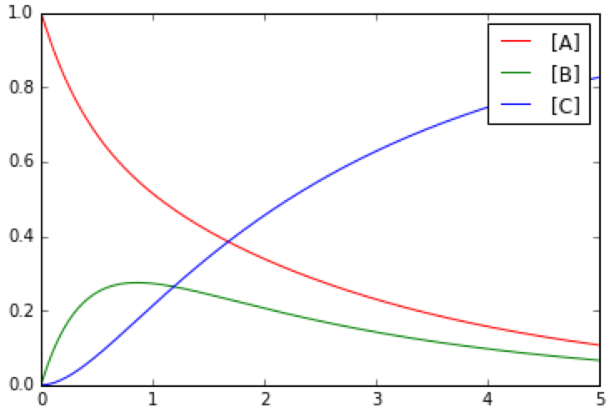
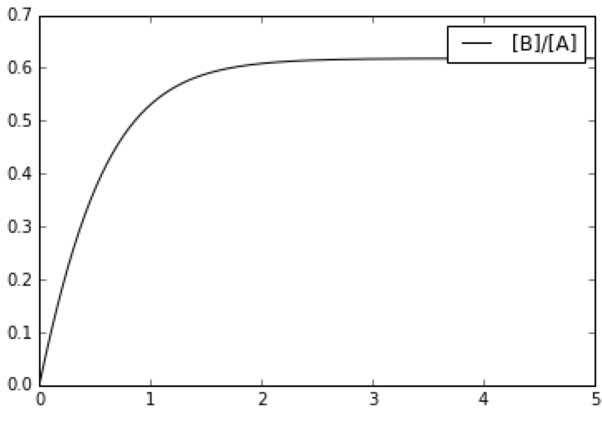
Step 13: Competitive Rates
To conclude this exercise, let’s examine the case where all the rate constants are set to 1.0:
The plot on the right shows that neither the pre-equilibrium nor steady state conditions apply until late in the reaction. This scenario represents the “perfect catalysis” scenario where all barriers are equal in height.

Slide 52
Summary: Import Statements
As you learned in this exercise, import statements are often needed to perform common tasks. Here are the imports we used:
For more functions and imports, see:
https://docs.python.org/2/library/math.html
http://docs.scipy.org/doc/numpy/reference/routines.math.html
http://docs.scipy.org/doc/scipy/reference/tutorial/basic.html
Stack Overflow (http://stackoverflow.com/) is also a good source of situation-specific imports.
Plotting
%matplotlib inline
import matplotlib
import matplotlib.pyplot as plt
Math
from math import sqrt, exp, log, log10
import numpy as np
Curve Fitting
from scipy.optimize import curve_fit

Slide 53
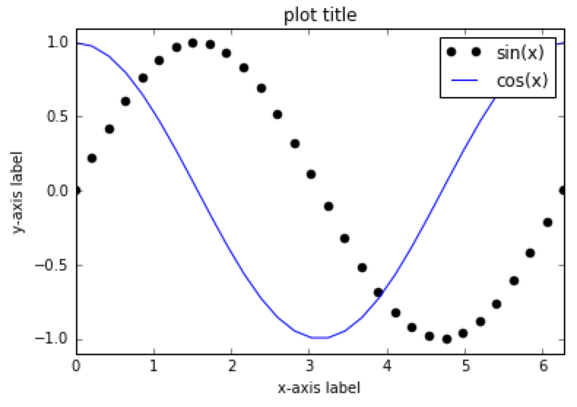
Summary: Code Fragments
Here are short code fragments that illustrate some of the things we learned.
They can be pasted into your notebook directly.
Plotting
# comments start with a hashtag
import matplotlib
import matplotlib.pyplot as plt
%matplotlib inline
import numpy as np
# make some data
x = np.linspace(0.0, 2*np.pi, 30)
# multiple plot statements will automatically overlay
plt.plot(x,np.sin(x),"ko”,label=“sin(x)”)
plt.plot(x,np.cos(x),”b”,label=“cos(x)”)
# set plot boundaries
plt.xlim(0.0,2*np.pi)
plt.ylim(-1.1,1.1)
# add a legend
plt.legend()
# add plot labels
plt.xlabel("x-axis label")
plt.ylabel("y-axis label")
plt.title("plot title”)
# save the plot in the current directory
plt.savefig("my_plot.png”)

Slide 54
Summary: Code Fragments
Lists
# basic list operations
list1 = [1.0, 3.0, 7.0]
list1[0] = 1.0
list1[1] = 3.0
list1[2] = 7.0
len(list1) = 3
# range(n) gives 0, 1, ..., n-1
list2 = [ i for i in range(5) ]
list2 = = [0, 1, 2, 3, 4]
# to take every n-th item
list3 = [ i for i in range(10) ]
list3[::5] = [0, 2, 4, 6, 8]
Math
# use “.0” after integers
from math import sqrt, exp, log, log10
import numpy as np
# addition, subtraction
1.0+2.0, 4.0-2.0
# multiplication, division
2.0*3.0, -4.0/5.0
# exponents
x ** y # x raised to the y
# square roots
sqrt(x)
# exponentials
exp(x) or np.exp(x)
# natural logarithms (ln)
log(x) or np.log(x)
# base 10 logarithms
log(x) or np.log10(x)
# linearly spaced values
np.arange(start,stop,stepsize)
np.linspace(start,stop,number_of_steps)

Slide 55
Further Reading
Congratulations! You now know how to perform simple kinetic analyses in Python!
Python:
https://www.codecademy.com/learn/python
http://learnpythonthehardway.org/book/index.html
NumPy and SciPy:
http://cs231n.github.io/python-numpy-tutorial/
http://www.engr.ucsb.edu/~shell/che210d/numpy.pdf
http://docs.scipy.org/doc/scipy/reference/tutorial/

